Slide 1
Project Demo

Slide 2
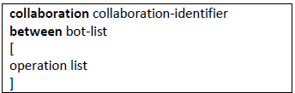
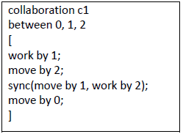
Language Definition
Collaboration abstraction – definition of what should be, reduce (or skip) the information how it is done
Extend BoCoLa with keyword sync:
Semantics: consist of two methods (method could be “work” or “move”), and these methods could be executed by bot(s) n
Contextual constrains: methods could be the same or different as well as bot number n, bot number n should be described in bot list

Slide 3
Language Translation
Defined tokens
Create BoCoLa AST
Extended with keyword sync
Synchronization performed
Used visitor pattern
Generate JAVA Code

Slide 4
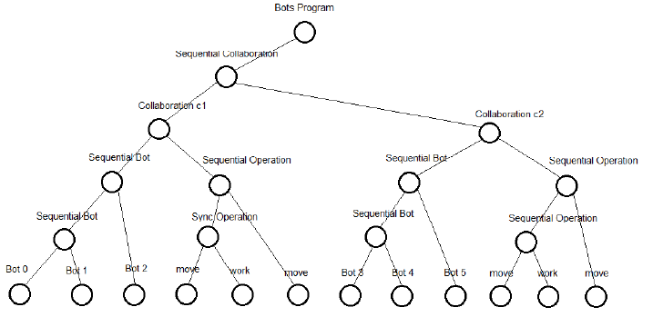
BoCoLa AST
Bots Program
Sequential Collaboration
Collaboration
Sequential Bot
Sequential Operation
move/work
Bot

Slide 5
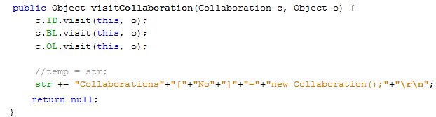

Visitor Pattern and Code Generation
Each tree node has method with parameter of visitor instance
Visitor node has methods with parameters of tree instances
Generate code from BoCoLa to Java, by using Java
BoCoLa
Java
Java

Slide 6

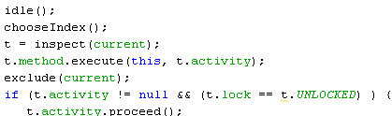

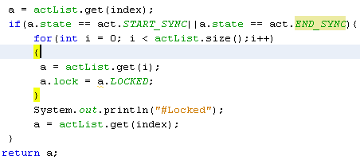
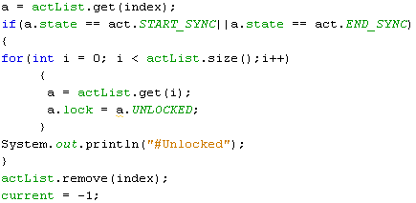
Modification of runtime system
Participant
Activity
Lock
Locked
Unlocked
Notes:
Modified runtime system allow us to execute in right order – synchronize. If in participant list there are synchronized bots when all other participants are locked and they have to wait until synchronized participants finish.

Slide 7
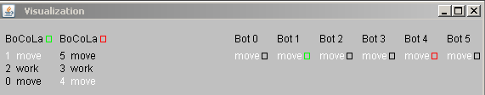
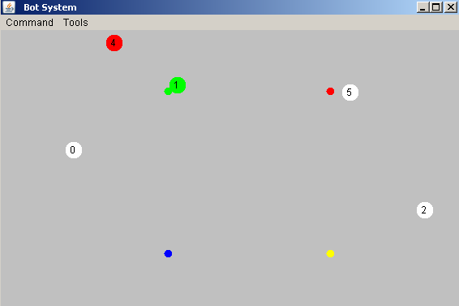
Results
Notes:
Picture of the Bots System runtime. Here are collaborations between bots.
By using the keyword sync it takes longer to execute, because of the wait. During synchronized bot execution no other bots execute. This guarantee right order of bots execution (move or/and work).

